Slide 1
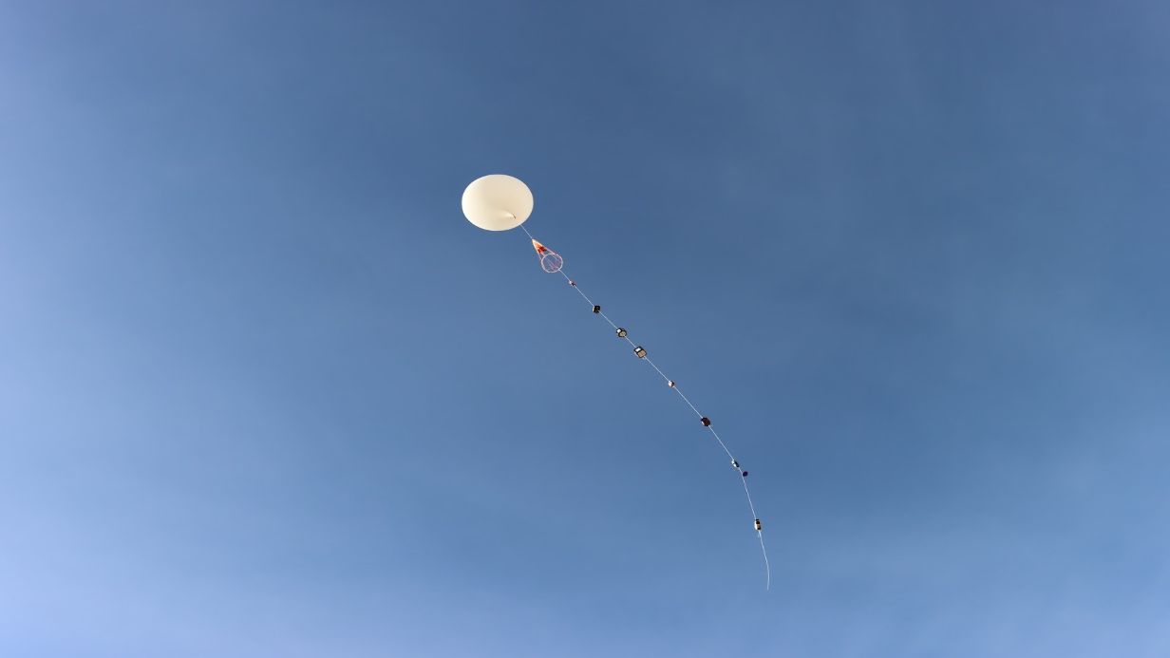
STRATODEVILS ASU ASCEND S23
Genevieve Cooper, Berkeley Adair, Anyell Mata, Jesse Ontiveros, Elizabeth Garayzar, Tamim Alsharif, Wilson Luu, Muhammed Topiwala, Derek Talbot

Slide 2






GOALS
PROFILE THE ATMOSPHERE
SUCCESSFUL LAUNCH AND RETRIEVAL OF PAYLOAD
DETERMINE RADIATION EFFECTS ON LETTUCE SEEDS
ESTABLISH CONNECTION WITH GROUND STATION
PAYLOAD STABILIZATION USING ADCS

Slide 3
Payload Housing
Printed Circuit Board
Switch
5V Regulator
microSD Card
Motor Driver
RTD
3.3V Regulator
Arduino Every
MPU6050
>7.2V Battery
(2)
5V Ports
MPRLS
PA1010D GPS
VOC
TMP36
Notes:
Two 5V ports for the pixhawk module and the LoRa module.

Slide 4

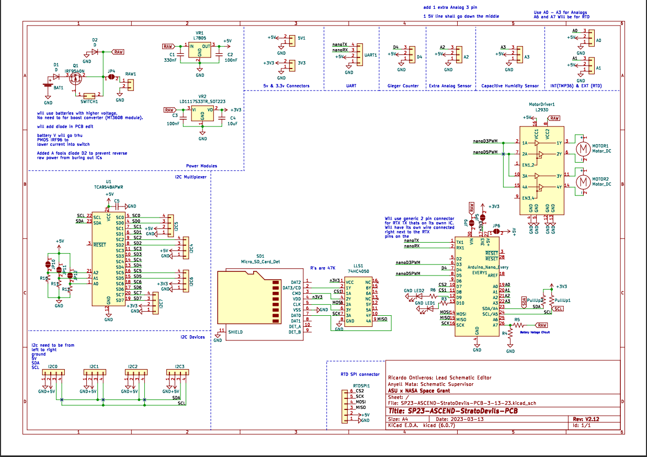
SCHEMATIC
Process/ Development
Universal PCB Schematic was updated this semester
Updated power systems
Added PMOS Switch
Created extra JST connections
Integrated SD card

Slide 5
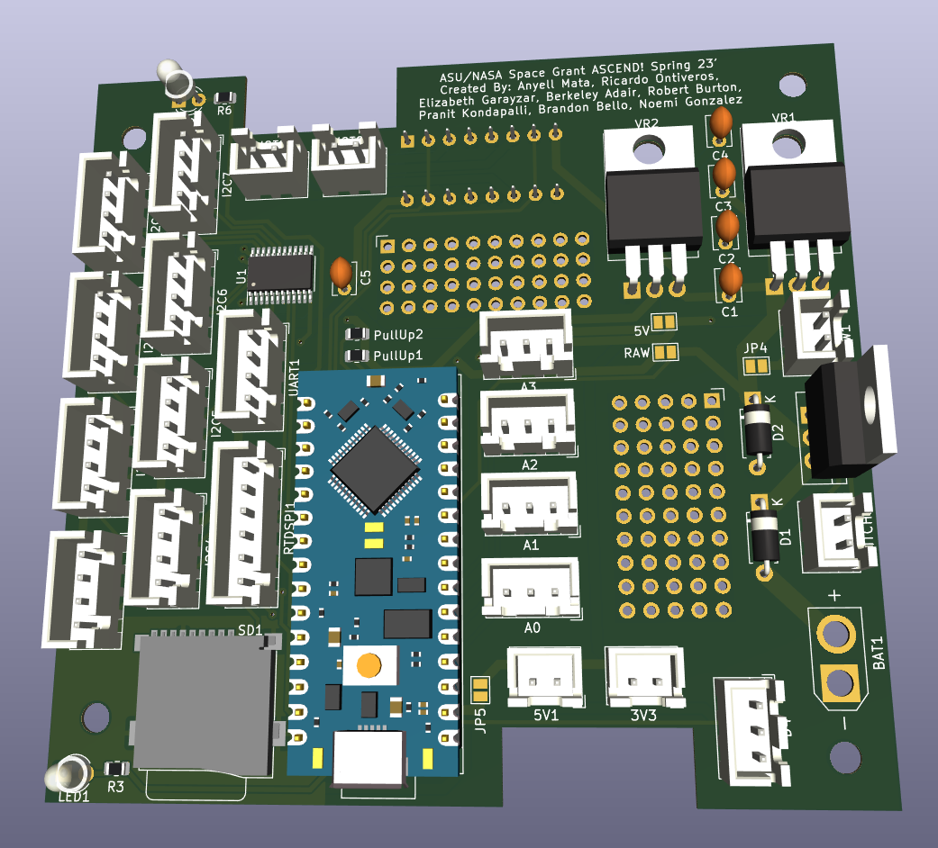
PRINTED CIRCUIT BOARD
Process/ Development
Designed a new PCB
PC104 design standard for 1U CubeSats
Extra Vias
Designed to be stacked in payload housing

Slide 6
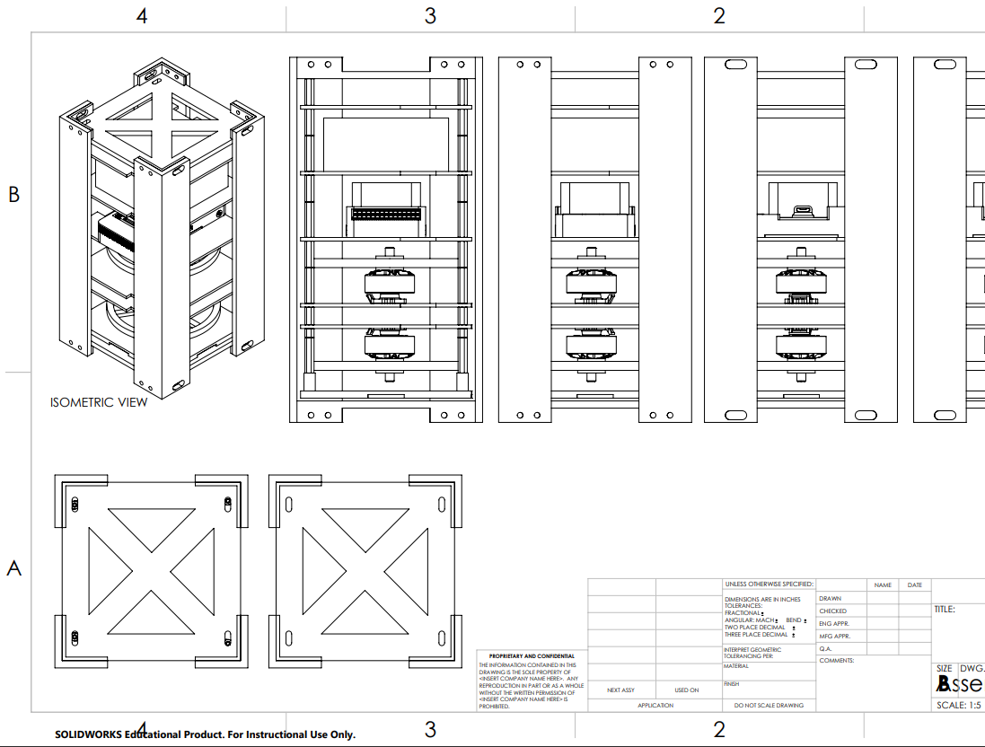
HOUSING
Modular and adaptable for future use
Aluminum CubeSat Design was too heavy (3.3lbs)
Outer housing is 2U foam core
Inner housing is PLA stacks

Slide 7
Housing Analysis
The payload critical components did survive
PCB
Motors
The housing of the payload did not survive
Cracked open
A couple of PLA failure points
Having better corner beams would have better dealt with the situation.
Allowing the shock to go through the payload
Key objectives met
Module design of the payload helped in last minute touches and fixes
Very simple to take apart and analyze due to the structure
Created a mock CubeSat which teaches FUNDAMENTALS CubeSat system design

Slide 8
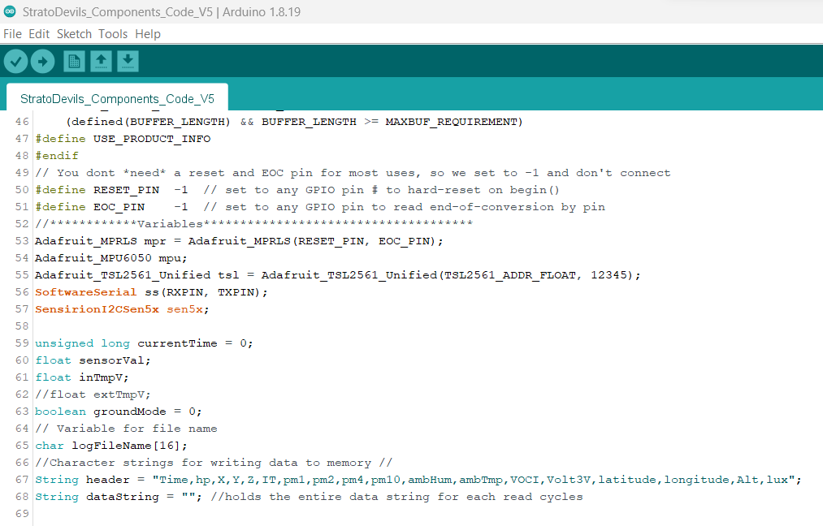

PROGRAMMING
Implementation of sensor code
Ensuring sensors function through testing
Code written Arduino programming
File sharing through Github
Data stored in SD as a CSV file
Website design

Slide 9
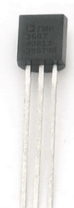
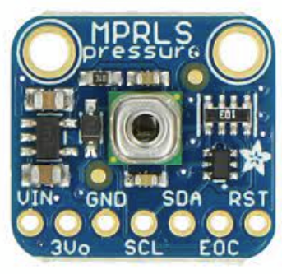
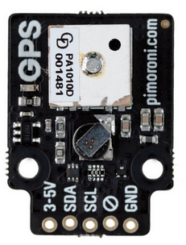
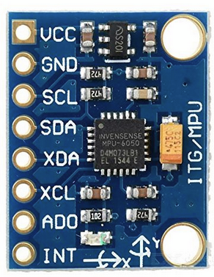
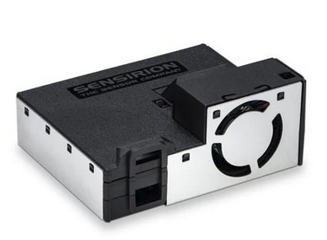
SENSORS
TMP 36 (Temp)
SEN55 (VOC)
MPU6050 (Accelerometer and Gyro)
MPRLS (Pressure)
PA1010D (GPS)
Notes:
Data was stored in CSV file
Unfortunately, heavy data losses due to lack of battery
TMP sensor and GPS sensor did not function as intended
Pressure and accelerometer okay

Slide 10
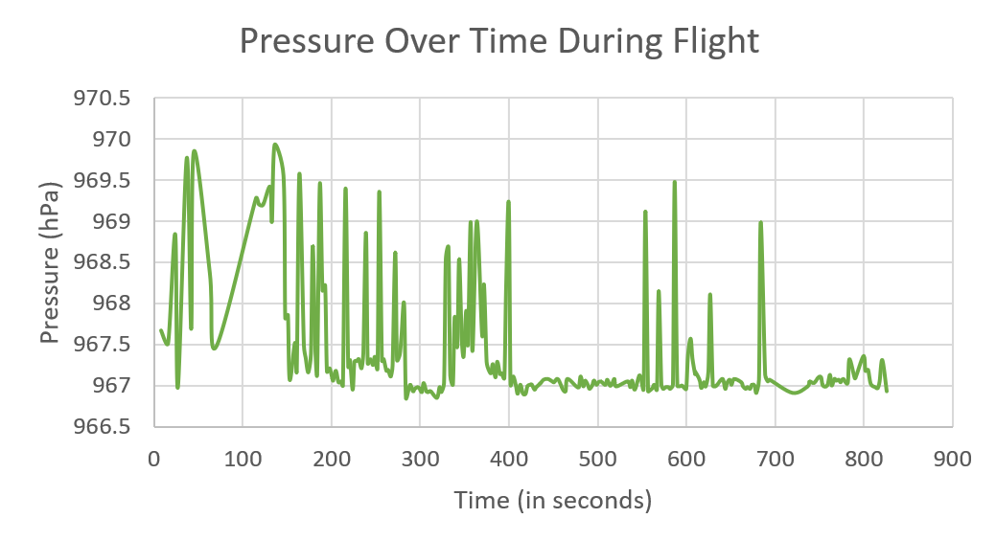

Slide 11
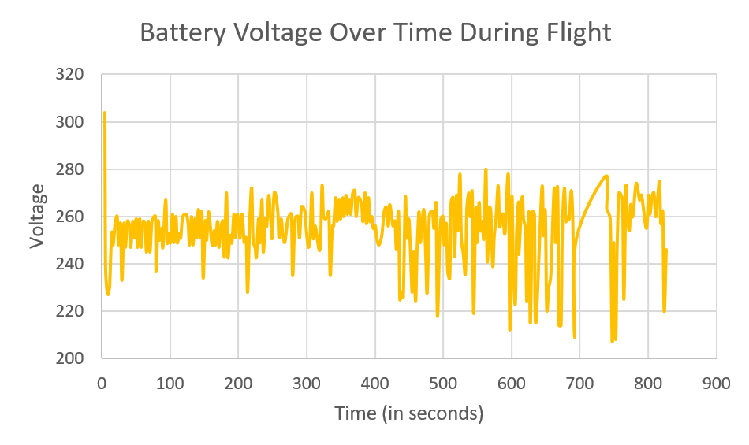

Slide 12
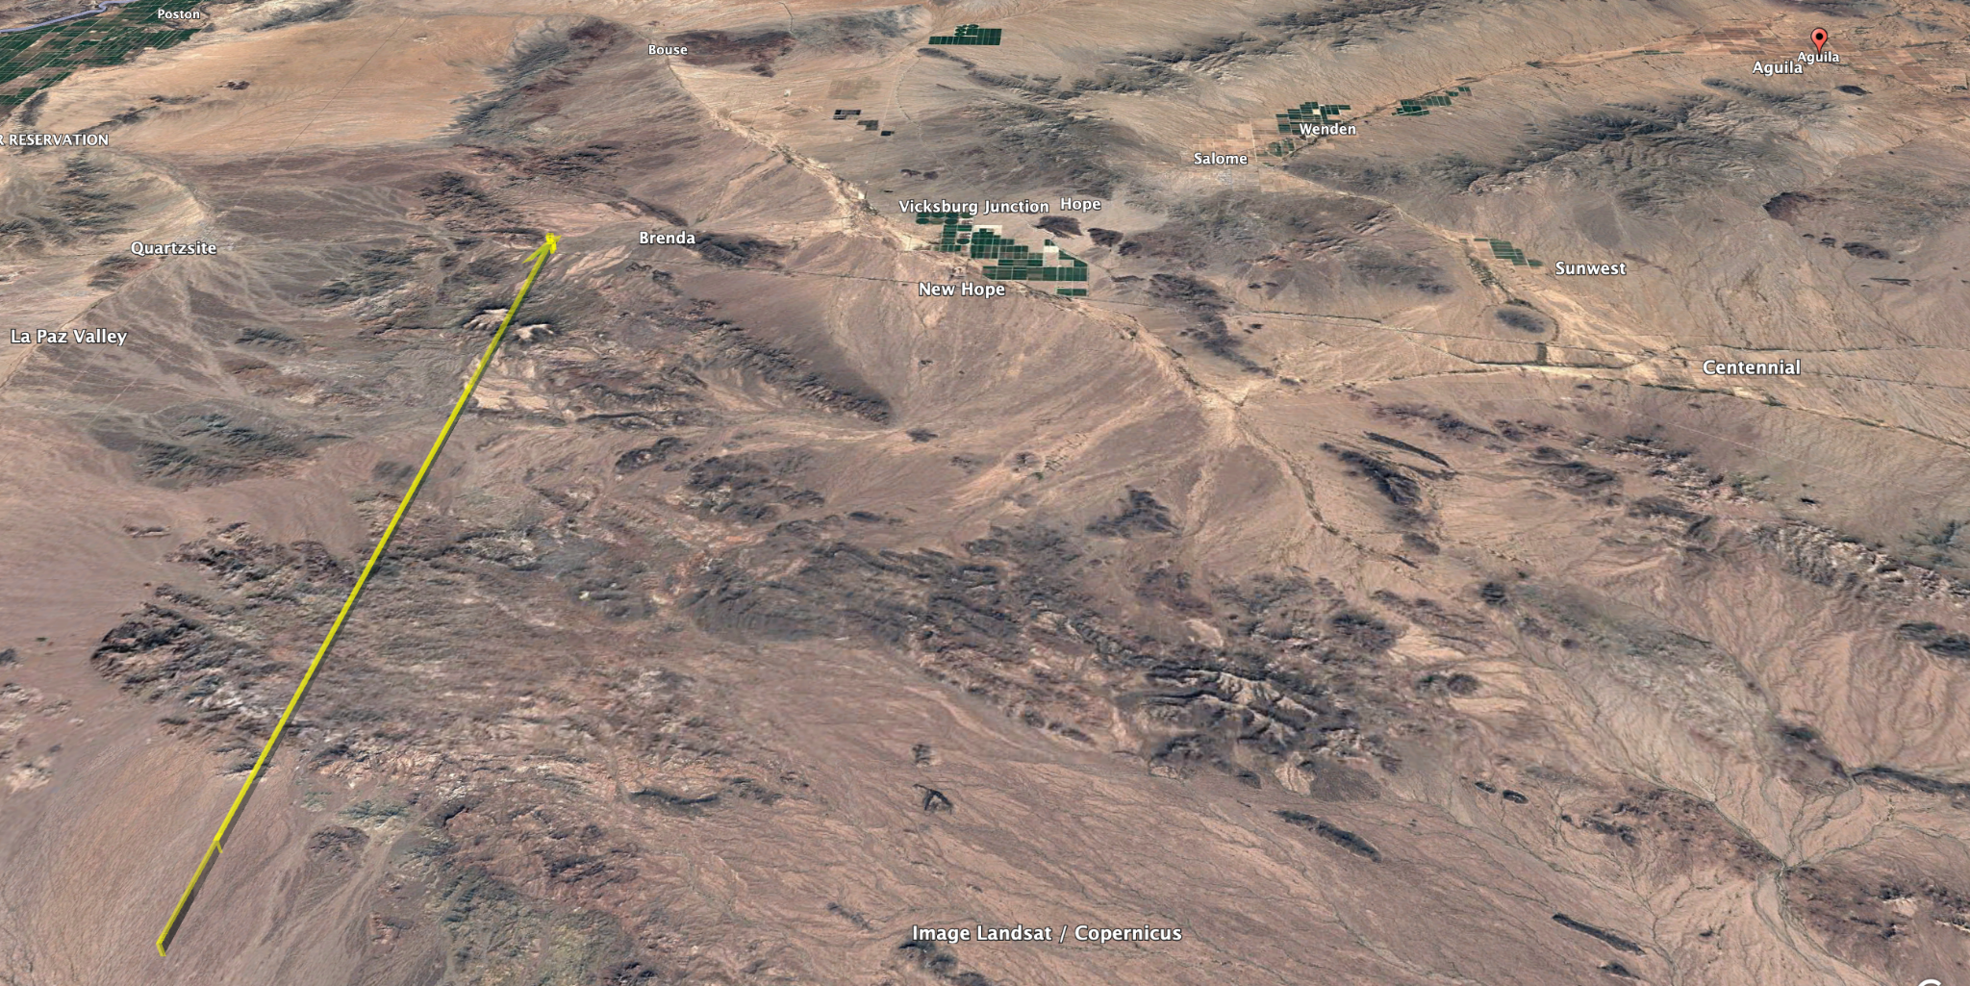
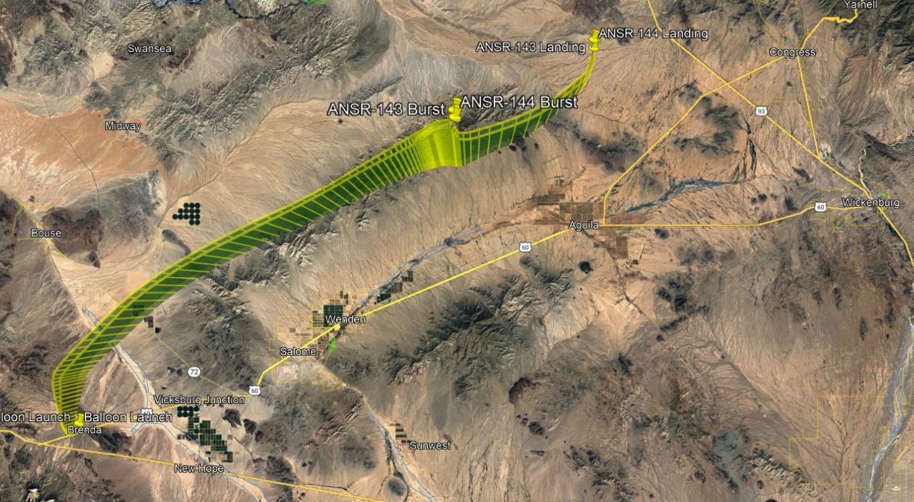

GPS READINGS
Successfully parsed NMEA sentences
GPS (Arduino PA1010D) recorded readings that are off by -π/2 radians

Slide 13
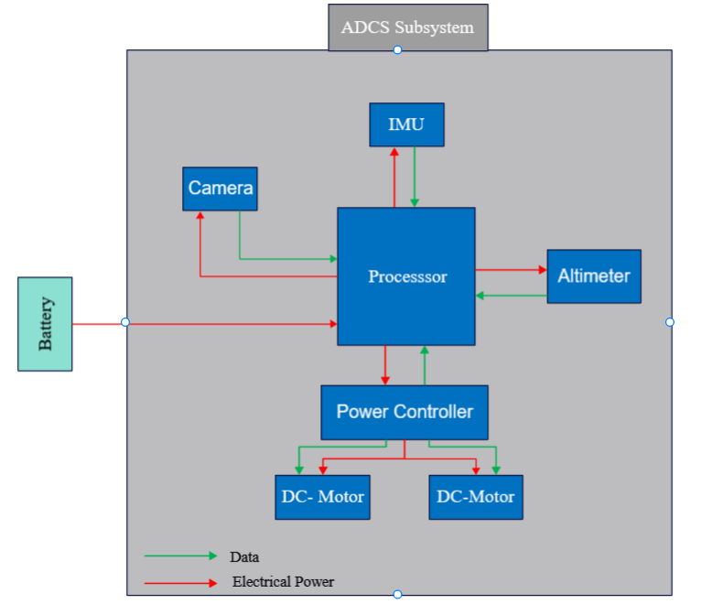
ADCS SYSTEM BLOCK DIAGRAM

Slide 14
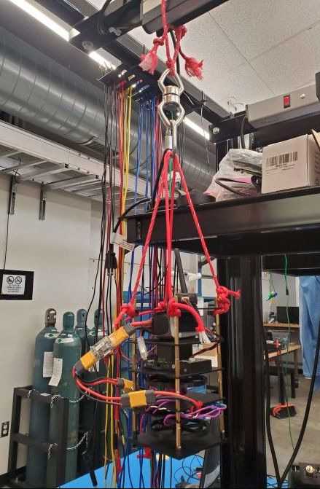
ADCS EXPECTED OUTPUT / DESIGN
Reaction Wheels placed vertically
Motors spin the opposite direction
the ADCS stabilizes on the Yaw axis
PX4 used as an autopilot to control the motor and stabilize it
PID controller for the system

Slide 15
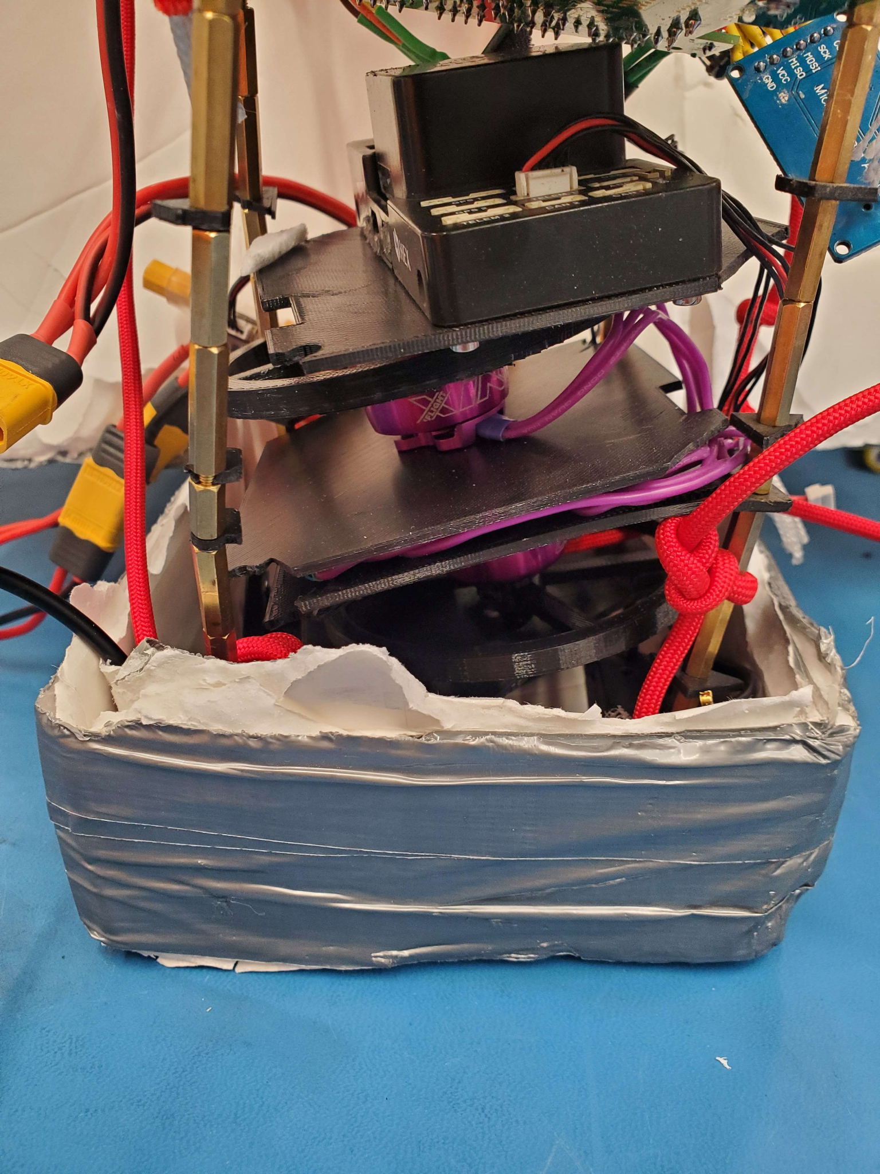
ADCS Analysis
The ADCS successfully armed
ADCS failed at stabilizing the entire payload
Disarm protocol at 40,000 ft failed
  Shortened battery life for others
Drone controller, motors, flywheels remained intact

Slide 16
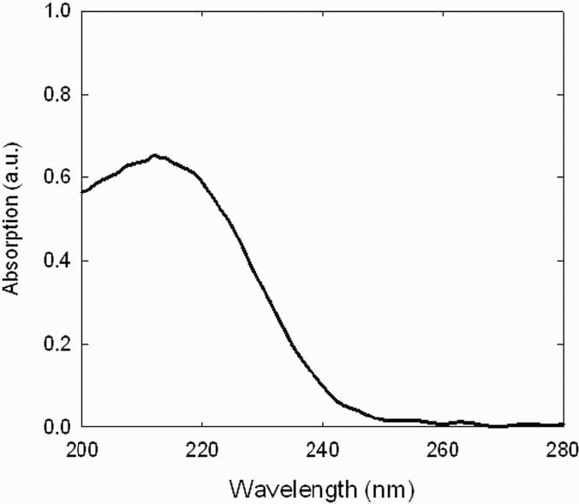
SEED MODULE
Mission
To determine the irradiating effects of a short near space flight on the germination rate of lettuce seeds
Little gem lettuce seeds
Cuvettes (PMMA) permit most of uv-b radiation
3 configurations: Shielded, unshielded, control
  Shielded went inside the payload
  Unshielded went on top of payload
  Control did not fly
Notes:
-The purpose of the seed Module science mission is to determine the irradiating effects of a short near space flight on the germination rate of lettuce seeds.
-lettuce seeds were chosen due to their small size, short germination period, and their lack of a thick shell or seed coat, meaning the inner embryo is most vulnerable.
-Enough damage to the embryo and it is no longer able to perform the metabolic functions needed to form into a sprout.
-In the case of uv radiation exposure this would likely occur from the destruction of enzymes alpha and beta amylase, which convert endosperm starches into energy and new plant materials.
-As far as the design of the module goes, it's really quite simple. A container of approximately 250 seeds is placed in the center of the payload providing relative shielding. A second container goes on top and is relatively unshielded to the uv radiation. And a third set of seeds does not fly as a control. In-flight instrumentation will help give insight to what conditions the seeds were subject to

Slide 17
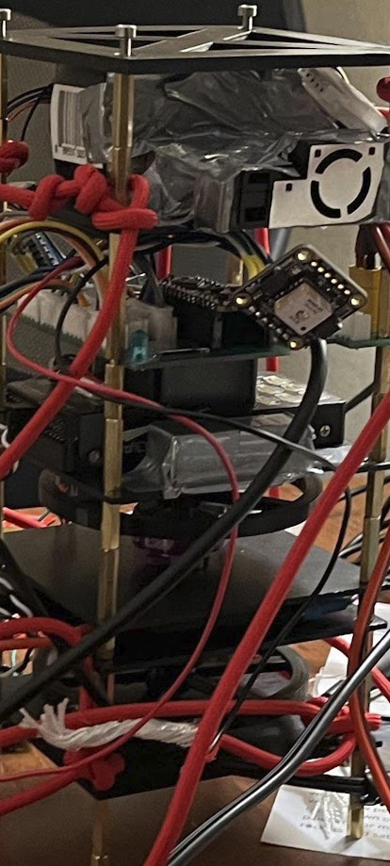
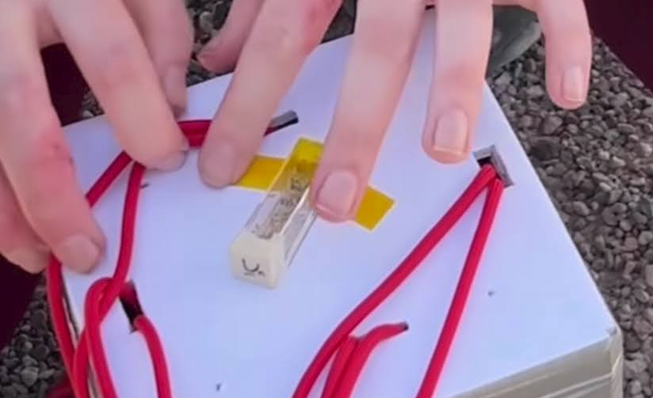
Seed Module Final Placement
Unshielded seeds on top of the payload
Shielded seeds inside the payload

Slide 18
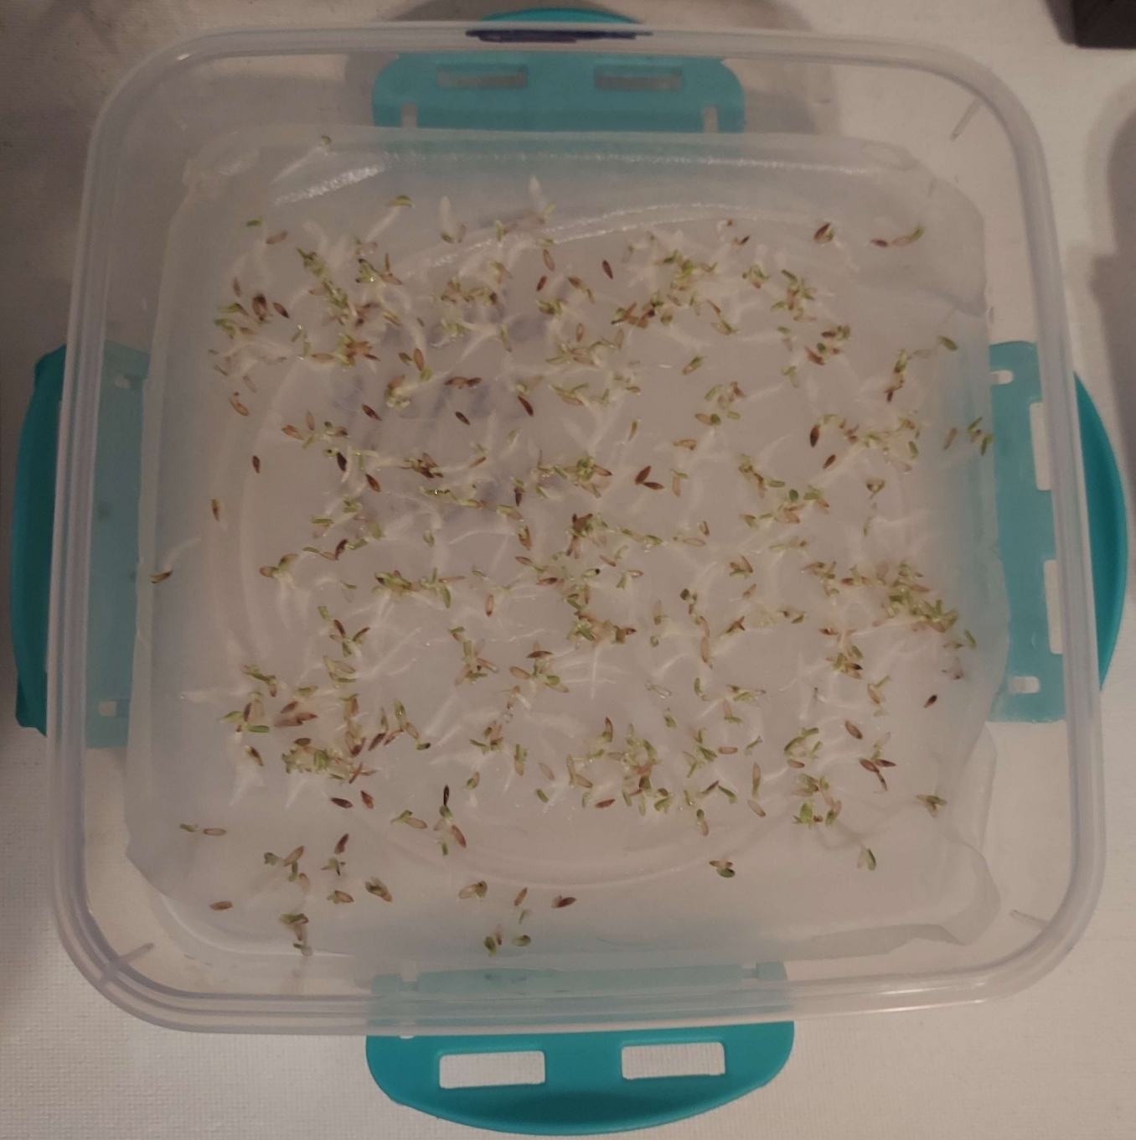
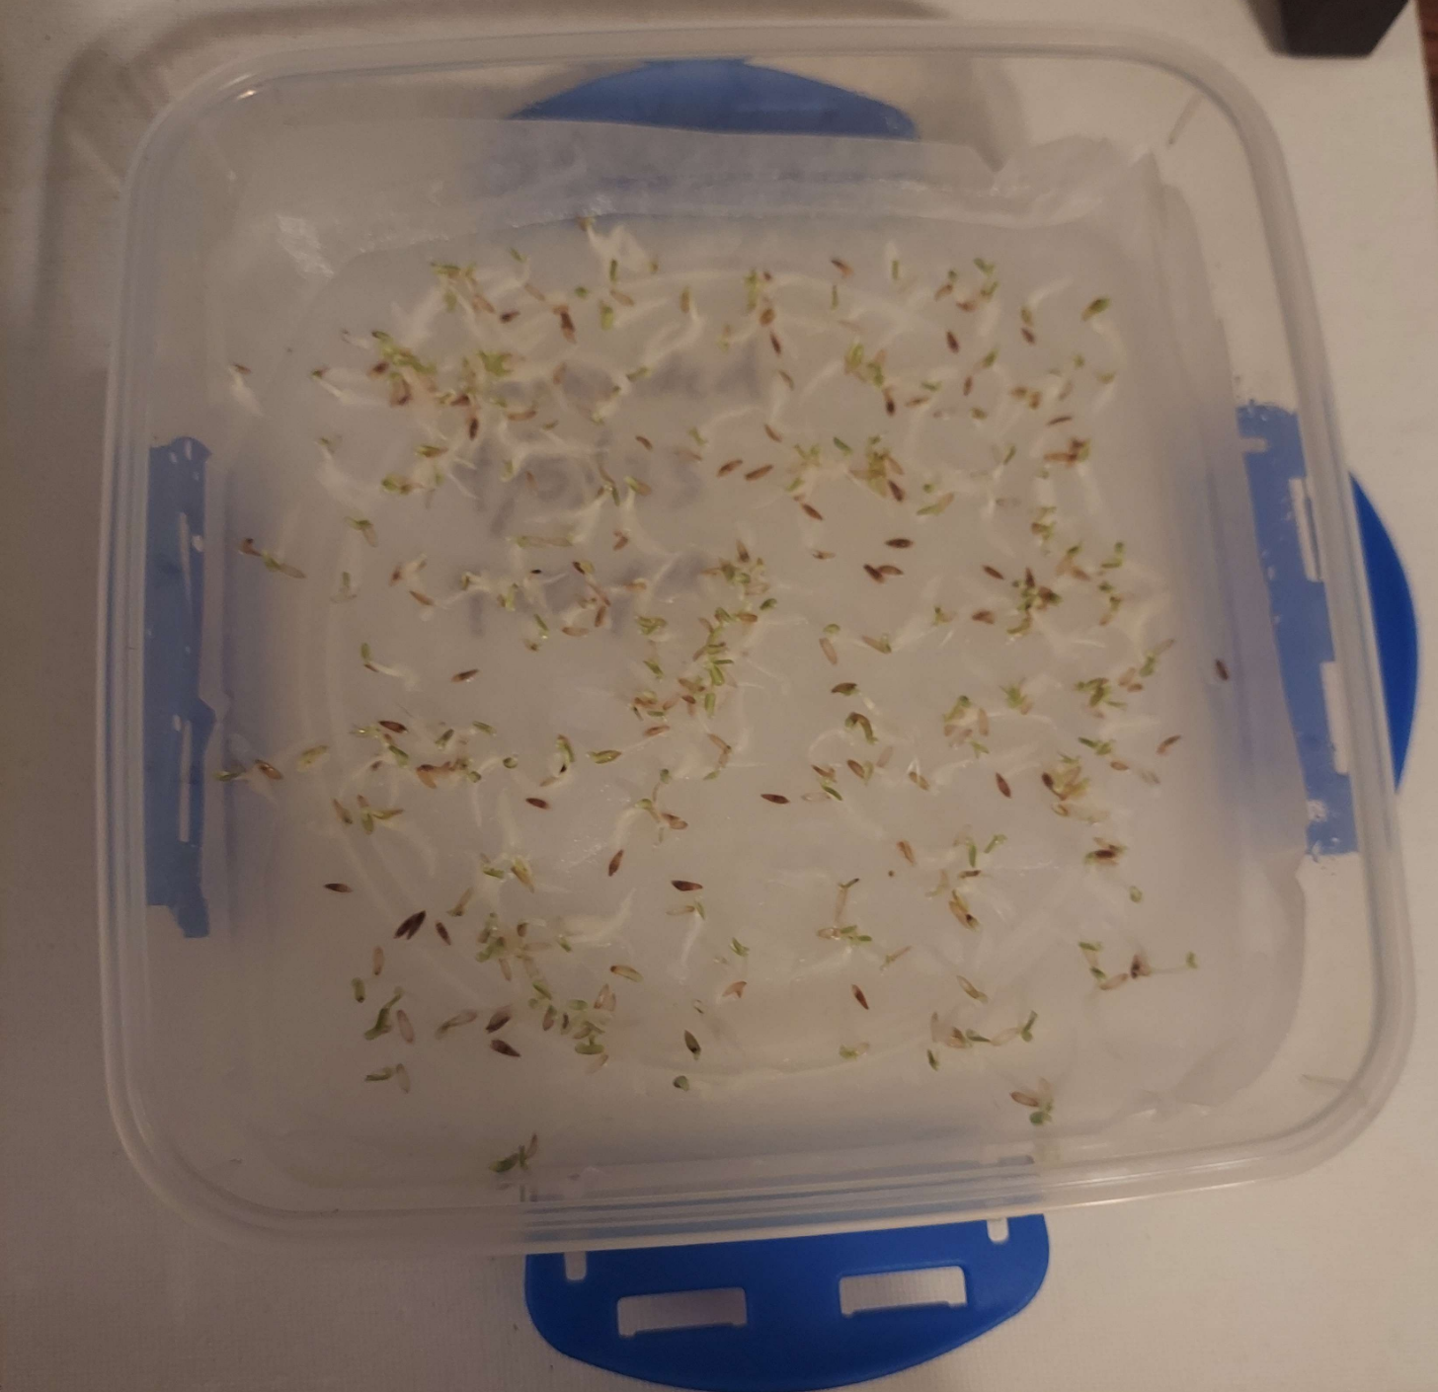
Methodology
Shielded Germination Test 96 hr.
Unshielded Germination Test 96 hr.

Slide 19
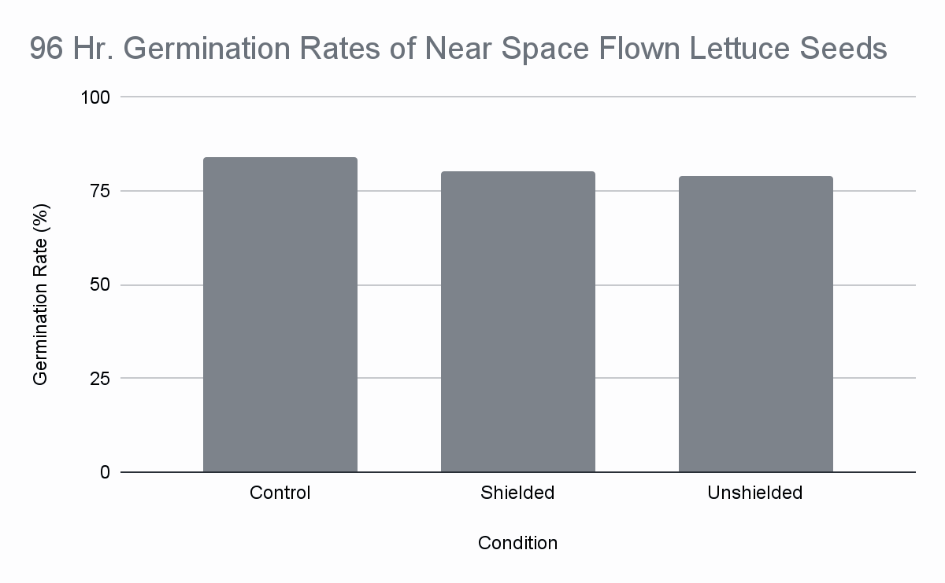
Seed Module Output
Unshielded results ARE NOT significant at the 5% significance level
83.9%
80.4%
78.8%
Notes:
Not significant, i.e. the germination rate of unshielded seeds is not outside the bounds of what we might expect from a control group.

Slide 20
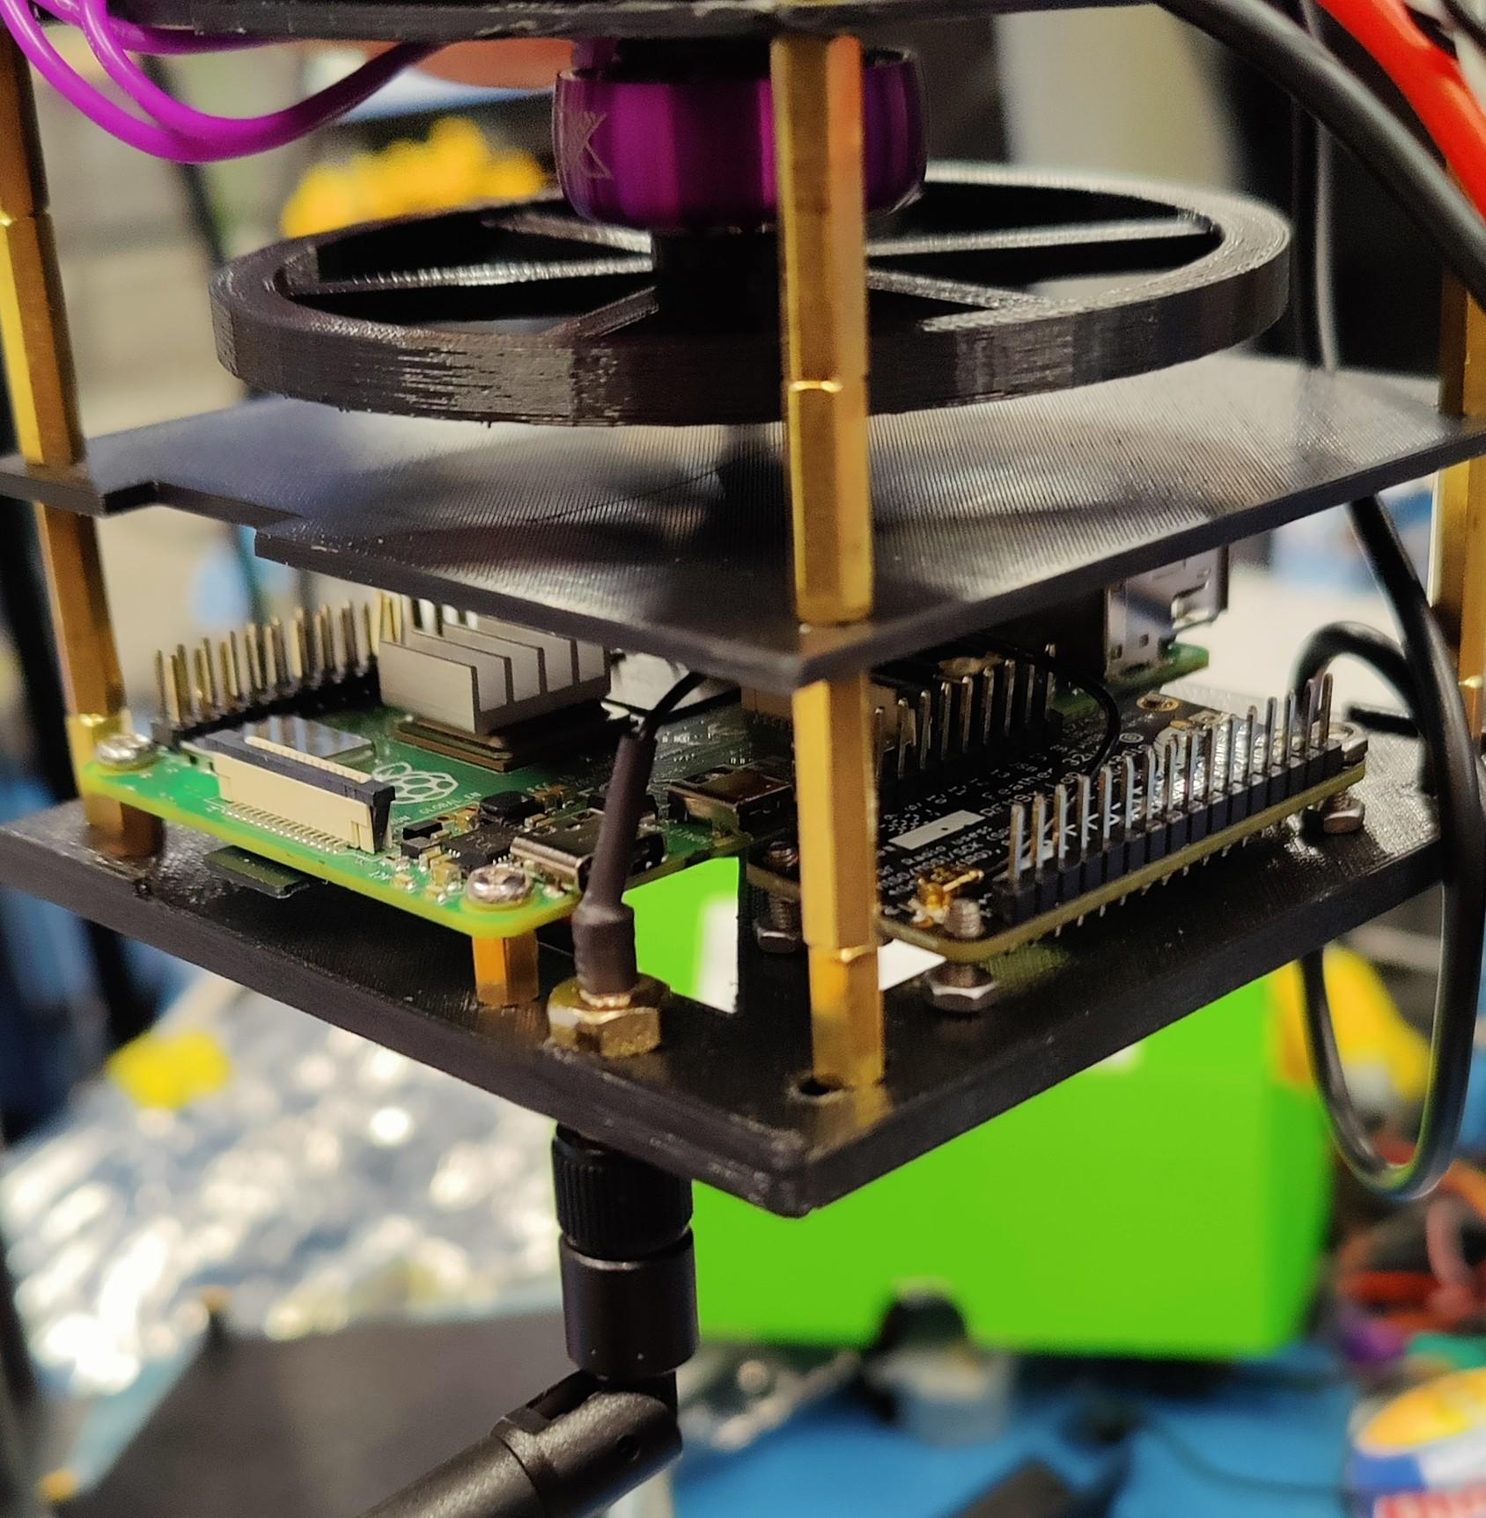

RADIO
Adafruit Feather 32u4 (RFM9x) with LoRa packet radio transceiver for long range tests
Pixhawk 4 flight controller used for ADCS and transferring flight telemetry
Working in 430 MHz Amateur radio band frequency
Radio transceiver codes GitHub->
Notes:
-IOT means internet of things and it is a network on small devices with wifi ability connected on a network or LoRaWAN communicating with a satellite
-430MHz frequency was allotted by ANSR for the launch

Slide 21
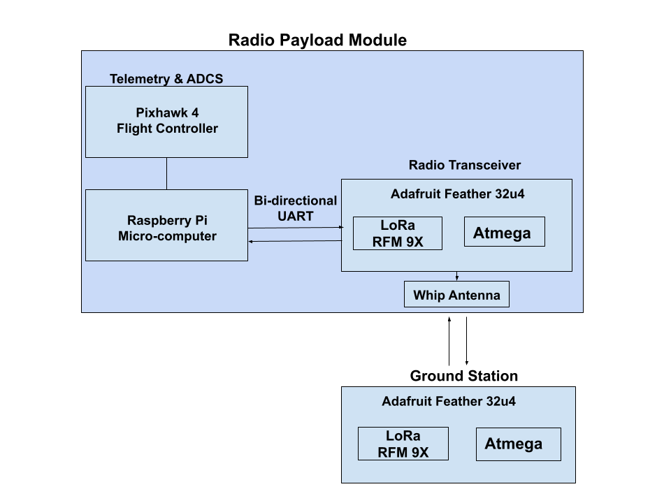
RADIO SYSTEM BLOCK DIAGRAM

Slide 22
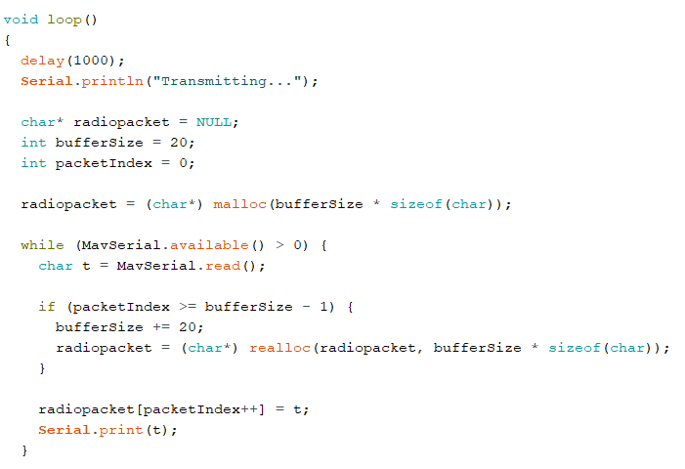
Radio Analysis
Successful communication established between radio module:
  Radio successfully received/transmitted telemetry
High losses experienced:
  Unstable Communication & receiving frequency decreased
  low strength antenna caused high loss
  Solution: Different antenna and increased TX power
Power connection problem faced:
  Connecting radio power supply with raspberry pi
  Solution: integrate RFM9x chip on OBC

Slide 23
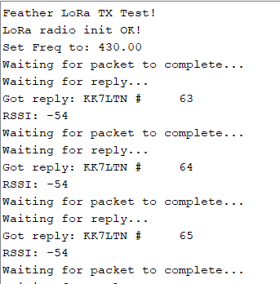
Radio Analysis Continued
Future application:
LoRa module will be used as payload for Coconut CubeSat
Data received

Slide 24
Conclusions
Pros
Cubesat design allowed for compact and modular
Main code and website is reusable for future semesters
PCB was versatile and adaptable for future use
Plant Module contributed to overall understanding of Radiation Effects
Radio established long range communication
Cons
Lower structural integrity
Need more storage or a different board (Raspberry Pi)
Electrical system needed more testing
Plant Module Data ultimately inconclusive/ insignificant
Radio module used was not robust or redundant

Slide 25
CREDITS
Full Name | Position | Subsystem
Jesse Ontiveros | Officer | Electrical
Elizabeth Garayzar | Officer | Electrical
Robert Burton | Member | Electrical
Noemi Gonzalez | Member | Electrical
Pranit Kondapalli | Member | Electrical
Luis Ángel Ruiz | Member | Programming
Muhammed Topiwala | Member | Programming
Brian Lee | Member | Programming
Brandon Bello | Member | Programming
Jessica Maschino | Member | Mechanical
Huy Dinh | Member | Mechanical
Jessica Cruz | Member | Mechanical
Arlene Morales | Member | Mechanical
Cindy Phan | Member | Mechanical
Ben Weber | Member | ADCS

Slide 26
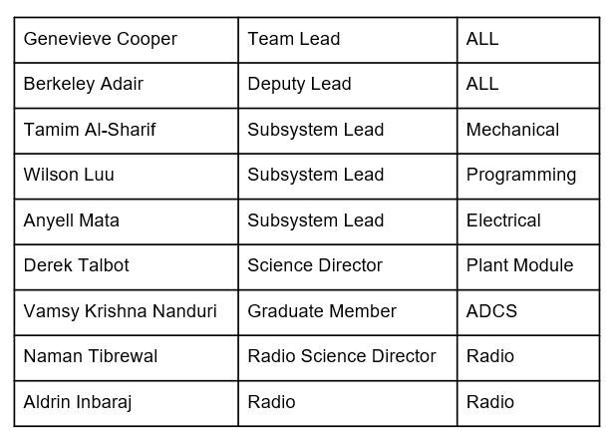

CREDIT CONTINUED
Dr. Tom Sharp
Dr. Jnaneshwar Das
Michelle Coe
Desiree Crawl
Deborah Blair
ANSR
SDSL
ASU ASCEND Website

